Slide 1

2020
Introduction of Spring MVC
Zach Chih

Slide 2
Hello World
Spring MVC
Appendix
MVC
Overview
Directory

Slide 3
Part 01
MVC

Slide 4
MVC
Model
The central component of the pattern. It is the application's dynamic data structure, independent of the user interface. It directly manages the data, logic and rules of the application.
Controller
Accepts input and converts it to commands for the model or view.
View
Any representation of information such as a chart, diagram or table. Multiple views of the same information are possible, such as a bar chart for management and a tabular view for accountants.

Slide 5
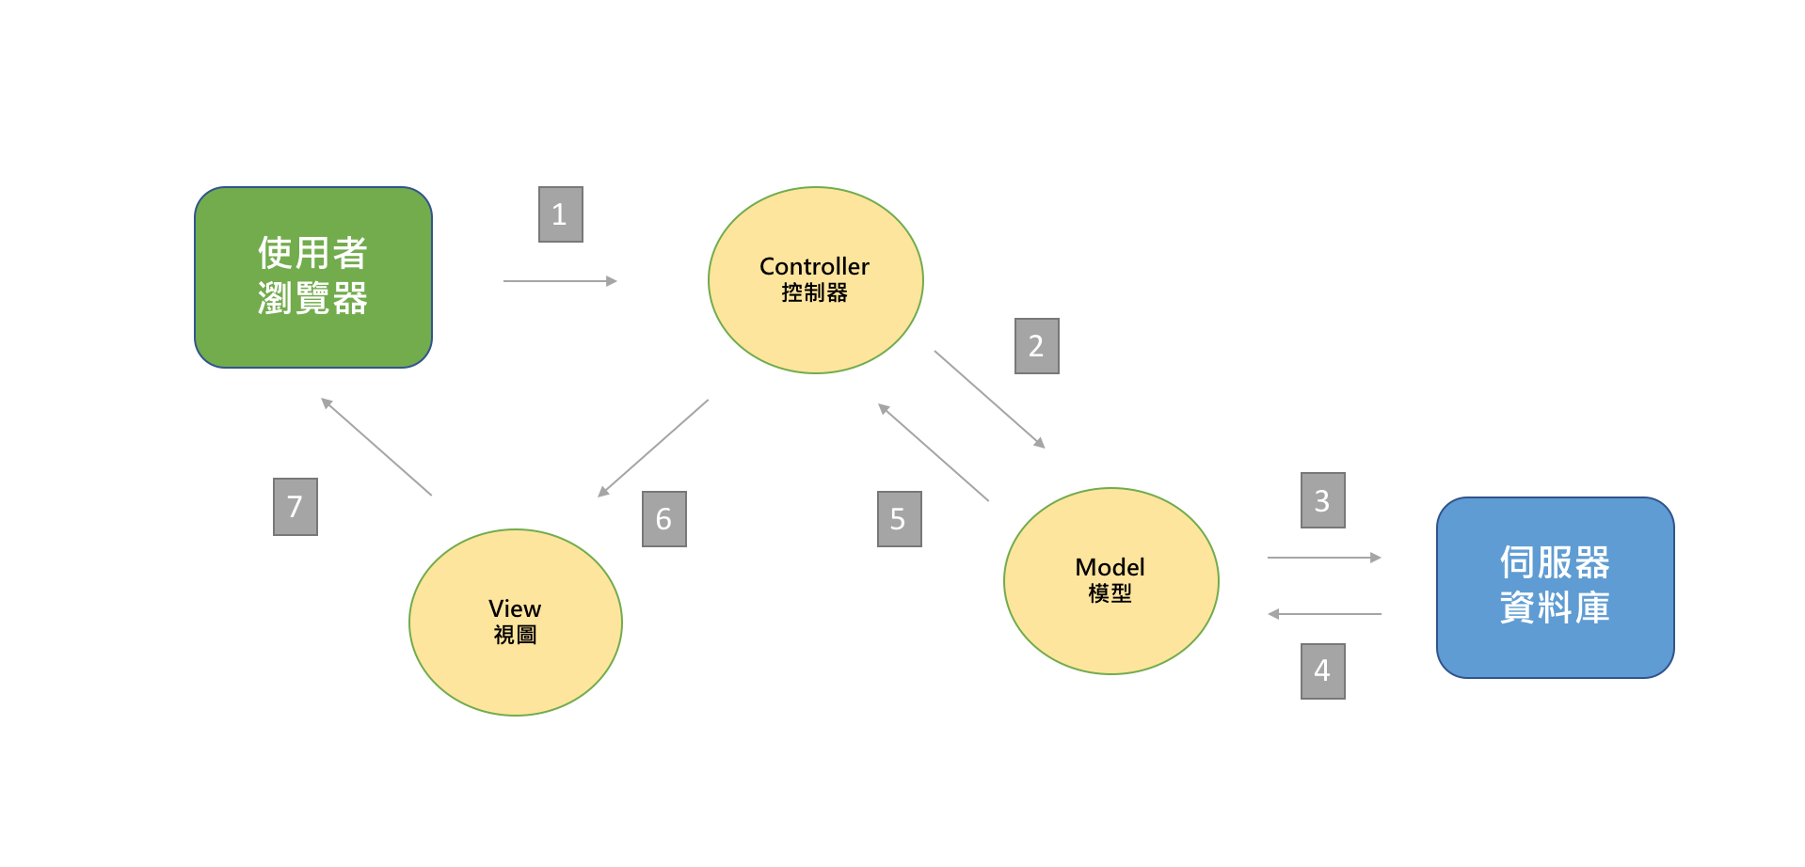
MVC

Slide 6
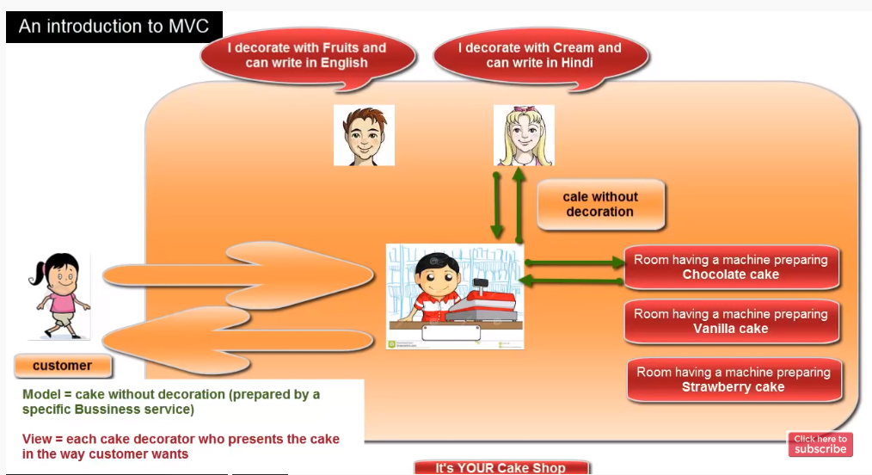
MVC

Slide 7
Part 02
Spring MVC

Slide 8
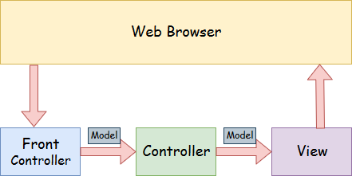
Spring MVC
A Spring MVC is a Java framework which is used to build web applications. It follows the Model-View-Controller design pattern. It implements all the basic features of a core spring framework like Inversion of Control, Dependency Injection.
Front Controller - In Spring Web MVC, the DispatcherServlet class works as the front controller. It is responsible to manage the flow of the Spring MVC application.

Slide 9
Spring MVC
Model - A model contains the data of the application. A data can be a single object or a collection of objects.
Controller - A controller contains the business logic of an application. Here, the @Controller annotation is used to mark the class as the controller.
View - A view represents the provided information in a particular format. Generally, JSP+JSTL is used to create a view page. Although spring also supports other view technologies such as Apache Velocity, Thymeleaf and FreeMarker.

Slide 10
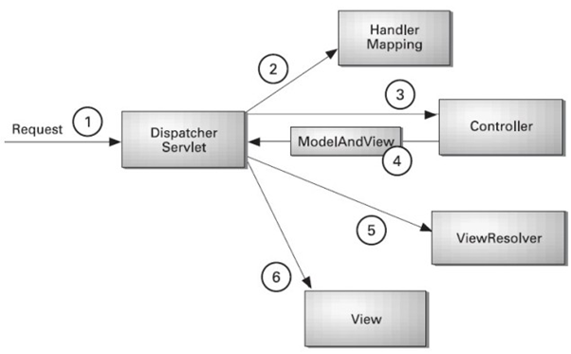
Spring MVC
As displayed in the figure, all the incoming request is intercepted by the DispatcherServlet that works as the front controller.
The DispatcherServlet gets an entry of handler mapping from the XML file and forwards the request to the controller.
The controller returns an object of ModelAndView.
The DispatcherServlet checks the entry of view resolver in the XML file and invokes the specified view component.

Slide 11
Why? Spring MVC
Separate roles
The Spring MVC separates each role, where the model object, controller, command object, view resolver, DispatcherServlet, validator, etc. can be fulfilled by a specialized object.
Light-weight
It uses light-weight servlet container to develop and deploy your application.
Powerful Configuration
It provides a robust configuration for both framework and application classes.
Rapid development
The Spring MVC facilitates fast and parallel development.
Reusable business code
Instead of creating new objects, it allows us to use the existing business objects.
Easy to test
In Spring, generally we create JavaBeans classes that enable you to inject test data using the setter methods.
Flexible Mapping
It provides the specific annotations that easily redirect the page.

Slide 12
Part 03
Hello World

Slide 13
Hello World
01
Maven Project
Load the spring jar files or add dependencies in the case of Maven
02
Controller
Create the controller class
03
Web.xml
Provide the entry of controller in the web.xml file
04
Servlet.xml
Define the bean in the separate XML file
05
View
Display the message in the JSP page
06
Get Started
Start the server and deploy the project

Slide 14
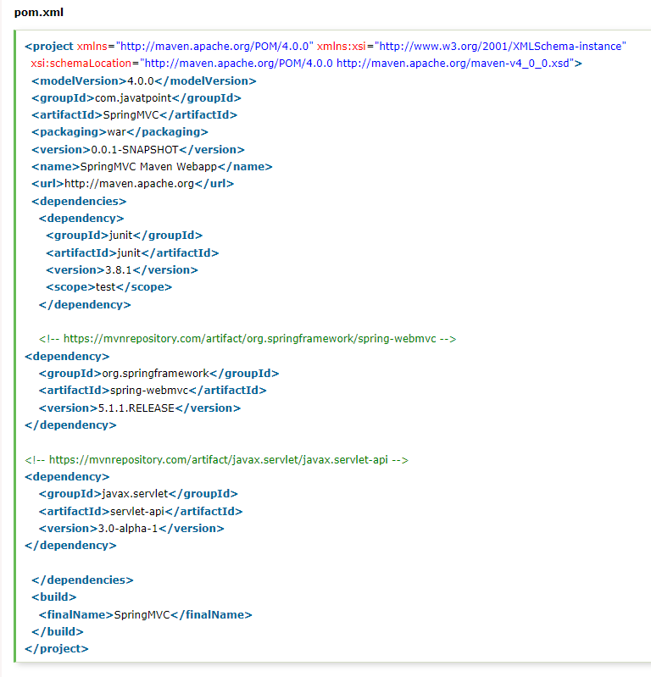
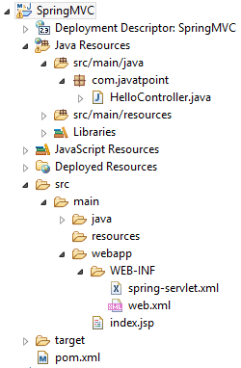
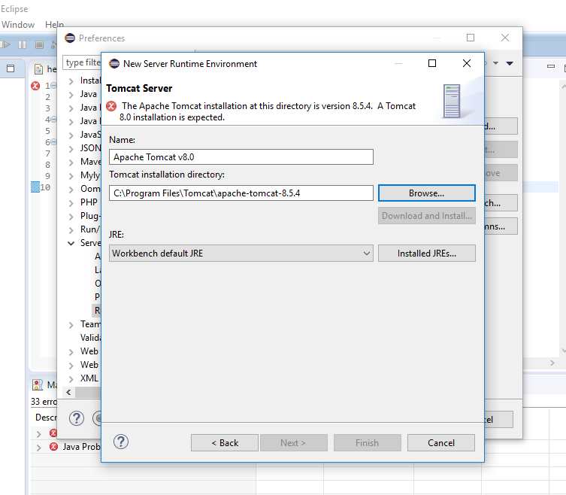
Maven

Slide 15
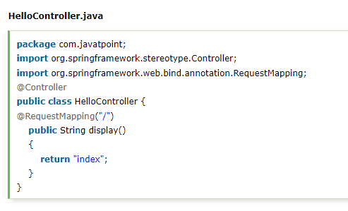
Controller
To create the controller class, we are using two annotations @Controller and @RequestMapping.
The @Controller annotation marks this class as Controller.
The @Requestmapping annotation is used to map the class with the specified URL name.

Slide 16
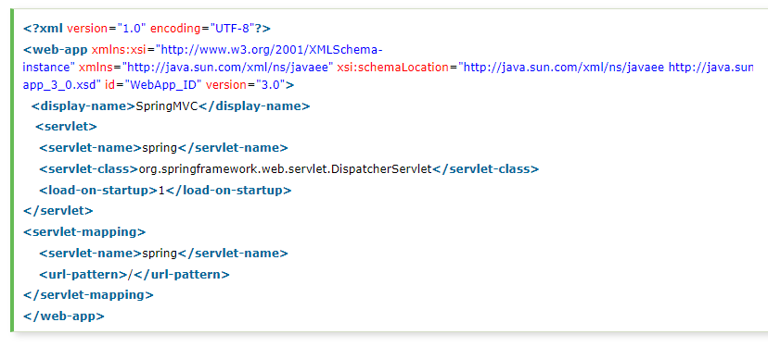
Web.xml
In this xml file, we are specifying the servlet class DispatcherServlet that acts as the front controller in Spring Web MVC.
All the incoming request for the html file will be forwarded to the DispatcherServlet.

Slide 17
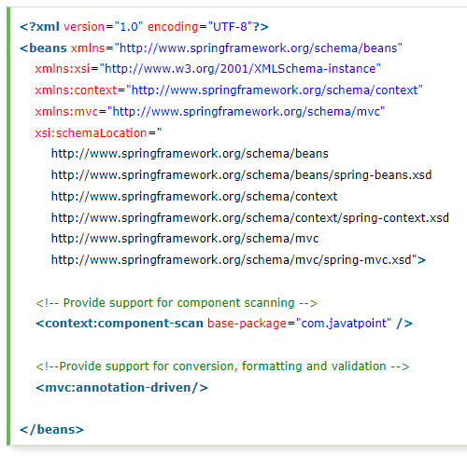
Servlet.xml
This is the important configuration file where we need to specify the View components.
The context:component-scan element defines the base-package where DispatcherServlet will search the controller class.
This xml file should be located inside the WEB-INF directory.

Slide 18
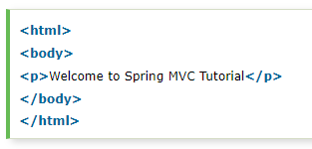
View
This is the simple JSP page, displaying the message returned by the Controller.

Slide 19
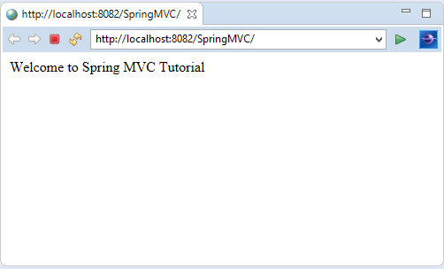
Get Started
PPT模板下载：www.1ppt.com/moban/ 行业PPT模板：www.1ppt.com/hangye/
节日PPT模板：www.1ppt.com/jieri/ PPT素材下载：www.1ppt.com/sucai/
PPT背景图片：www.1ppt.com/beijing/ PPT图表下载：www.1ppt.com/tubiao/
优秀PPT下载：www.1ppt.com/xiazai/ PPT教程： www.1ppt.com/powerpoint/
Word教程： www.1ppt.com/word/ Excel教程：www.1ppt.com/excel/
资料下载：www.1ppt.com/ziliao/ PPT课件下载：www.1ppt.com/kejian/
范文下载：www.1ppt.com/fanwen/ 试卷下载：www.1ppt.com/shiti/
教案下载：www.1ppt.com/jiaoan/
字体下载：www.1ppt.com/ziti/

Slide 20
Part 04
Appendix

Slide 21
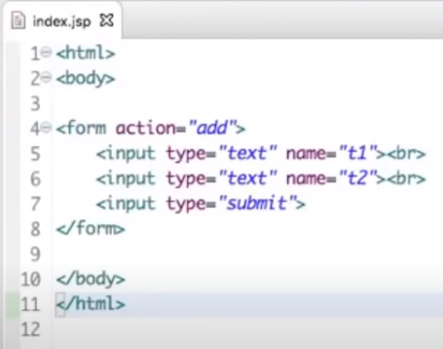
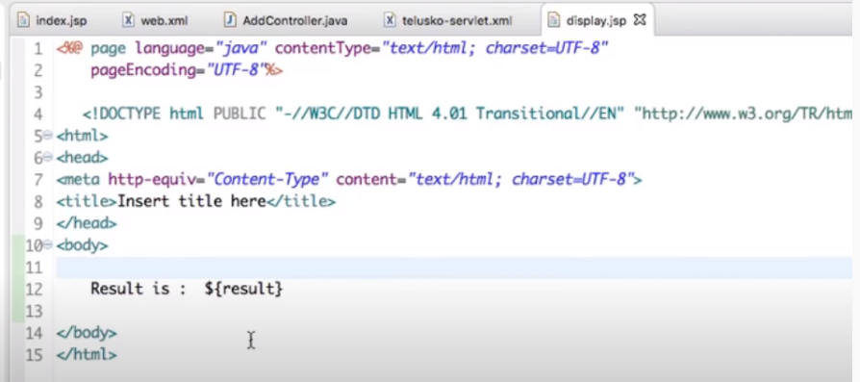
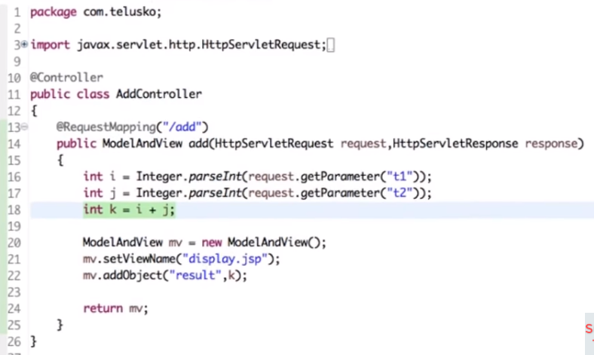
ModelAndView
Expression Language

Slide 22
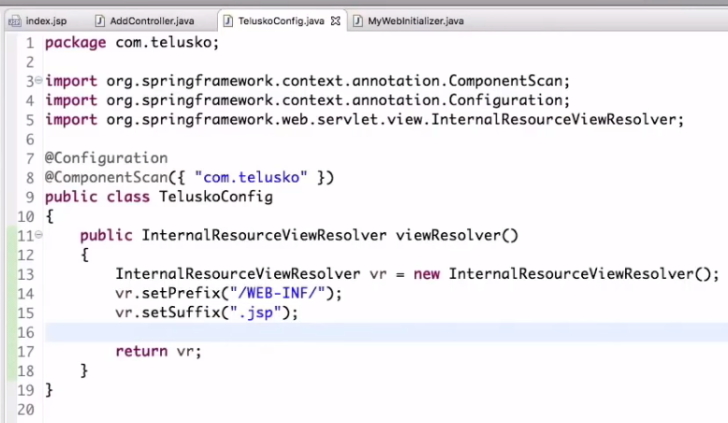
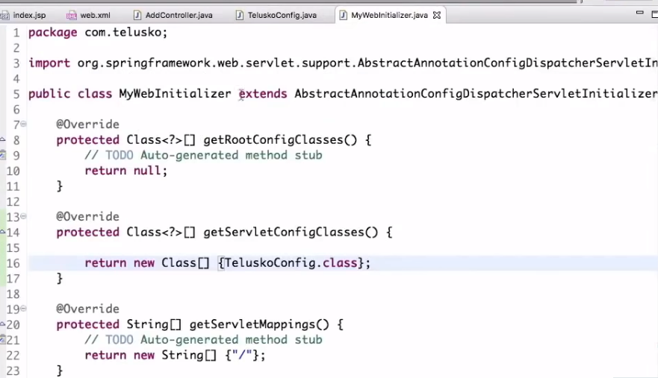
Configuration
viewResolver

Slide 23
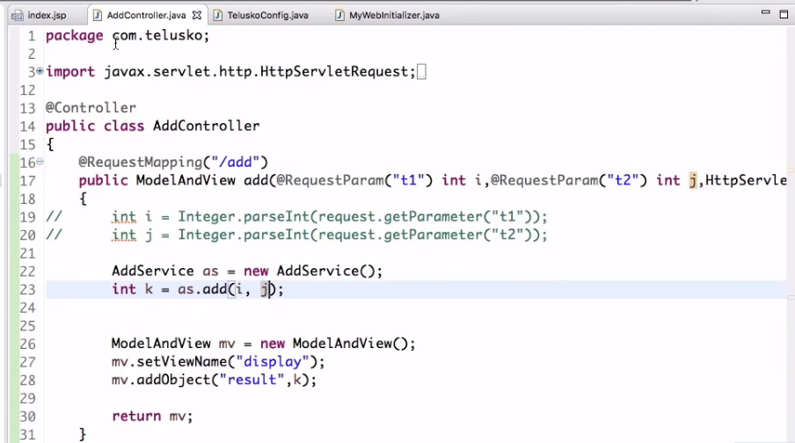
RequestParam

Slide 24
Thanks for listening

